Slide 1
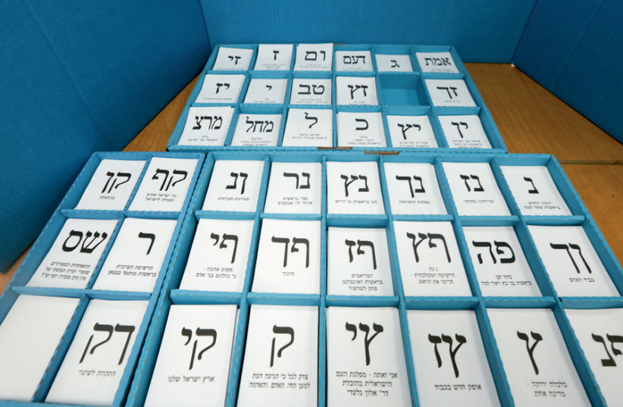

Israeli Election
21st - 22nd - 23rd
Time period: After 23rd election

Slide 2
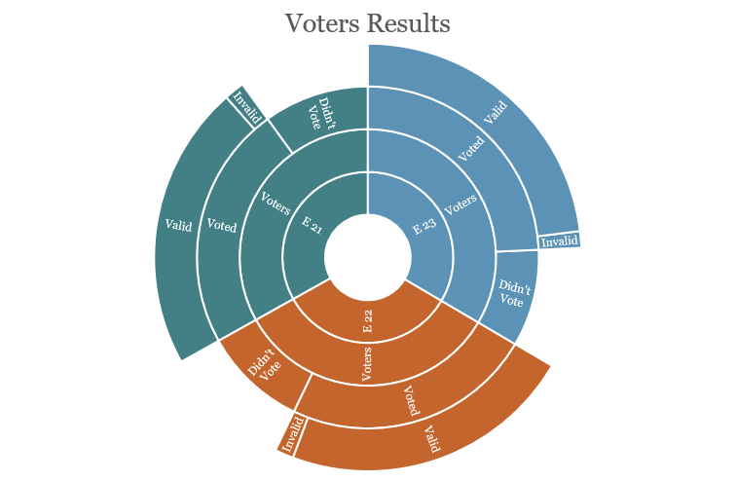
Israeli Settlements - Demographic
We placed our data in an excel sheet and created graphs to see the total results in the 3 elections.
We created new sheets with the combination of the settlements indexes and features according to the election votes in each.
Total 8.5mil
Jewish 6.3mil
Arabs 1.8mil
Other 400k
Population - 2018
 | Voters | Voted | Didn’t vote | Valid | Invalid
E 21 | 6.33mil | 4.34mil | 1.99mil | 4.30mil | 30983
E 22 | 6.39mil | 4.43mil | 1.95mil | 4.43mil | 28362
E 23 | 6.45mil | 4.61mil | 1.83mil | 4.59mil | 25073

Slide 3
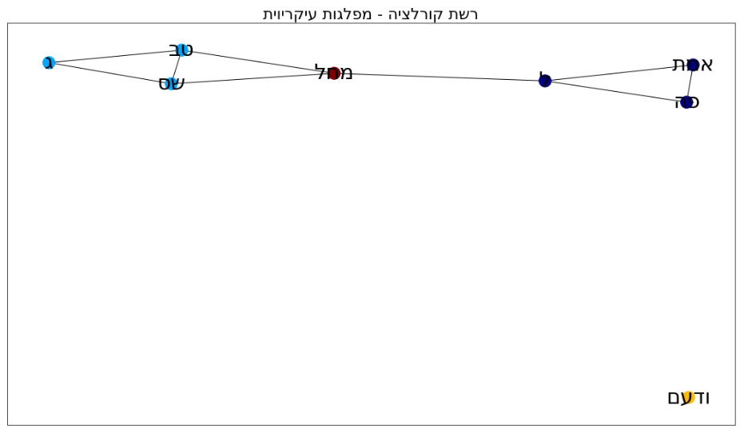
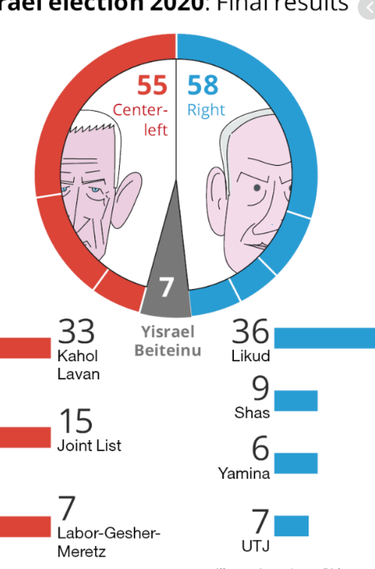
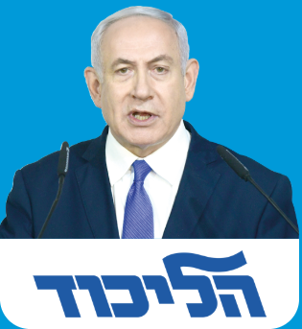
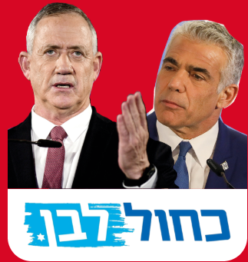
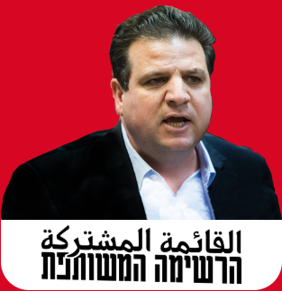
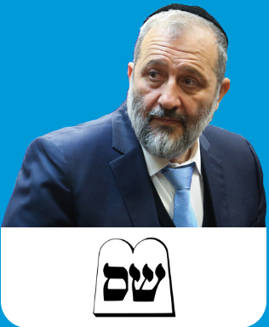
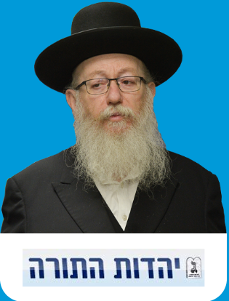
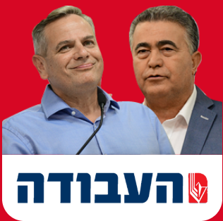
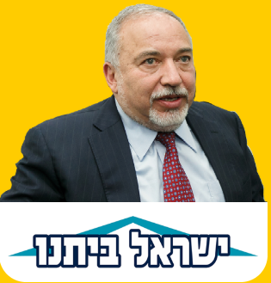
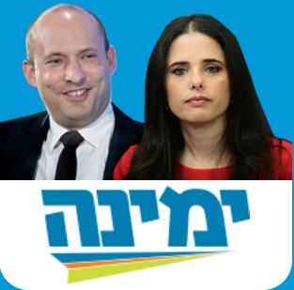
Meet The Major Parties - Knesset Seats
Left-wing Parties
Right-wing Parties
Blue & White
Labor - Meretz
Yisrael Beiteinu
Joint List
Likud
United Thora
Shas
Yamina

Slide 4
Settlements Distribution Voting Clustering
We examined our features with correlation and scatter matrixes. We chose the best to use in each Clustering.
Results:
Likud and Blue & White are the largest parties in Israel.
The Arab Joint party have become the 3rd largest party in Israel, after they merged in the 21st election with 2 more Arab parties.
The Religious people in Israel are dividing in to 2 main parties – Shas and UTJ
In district Center and South most of the population votes for Likud party.
In Jerusalem most votes go to Likud and UTJ whereas most of Tel – Aviv votes, go to Blue & White
Most of the votes in Yishuv form - # 310 – Moshav go to Blue & White

Slide 5
Vote Predictions
Valid Voted
Party Votes
Karmiel
Daliyat al-Karmel
Bnei Brak
Featured used:
District, settlement form and religious, total inhabitants, Jewish and Arabs and number of voters
Jerusalem
Featured used: Total inhabitants and Arabs.
Likud: Napa,
Joint list: Number of voters and Jewish others.
Blue & White: Number of voters, Jewish, Napa and settlement religious.
Sakhnin
Real
Predicts

Slide 6
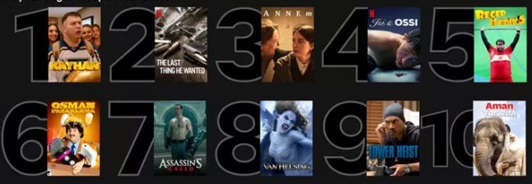
Conclusions - Inspection
We calculated the ratio with number of invalid voted and sqrt of voters. This way we gave the largest cities a larger effect on the results.
Analysis showed that there are more then 250 settlements where supervision is needed.
Settlement Form : Yishuv Irony have 32 settlements and Moshav have 21 settlements where need supervision is needed
There are 0.61% of Arab settlments where supervision is needed.
District North (2) have 67 settlements & District Center (4) have 44 settlements.
Top – 10
בני ברק
ירושלים
באר שבע
מודיעין
חיפה
אשדוד
תל אביב
בת-ים
נתניה
רמלה
Featured used: Settlement religious, Jewish and Other, Arabs and number of voters
Featured used:
Settlement religious, Jewish and others, Arabs and number of voters

Slide 7
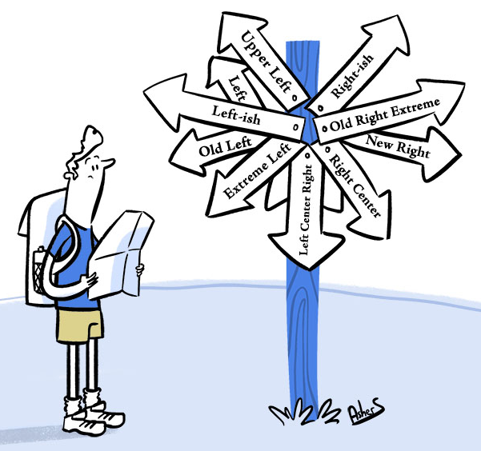
Questions?

